Slide 1
FCAWA Member Survey 2022
88% had worked with clients at risk of suicide
82% had worked with clients bereaved by suicide
65% confident in responding to clients at risk of suicide
53% confident responding to clients bereaved by suicide
75% aware of local support service for at risk clients
36% aware of local support service for clients bereaved by suicide

Slide 2
FCAWA Postvention Model
Impacts
Safe language
Notifications and responsibilities
Support for clients
Self support
Professional supervision
Resources
SAFETY
COMMUNICATION
SUPPORT
REVIEW

Slide 3
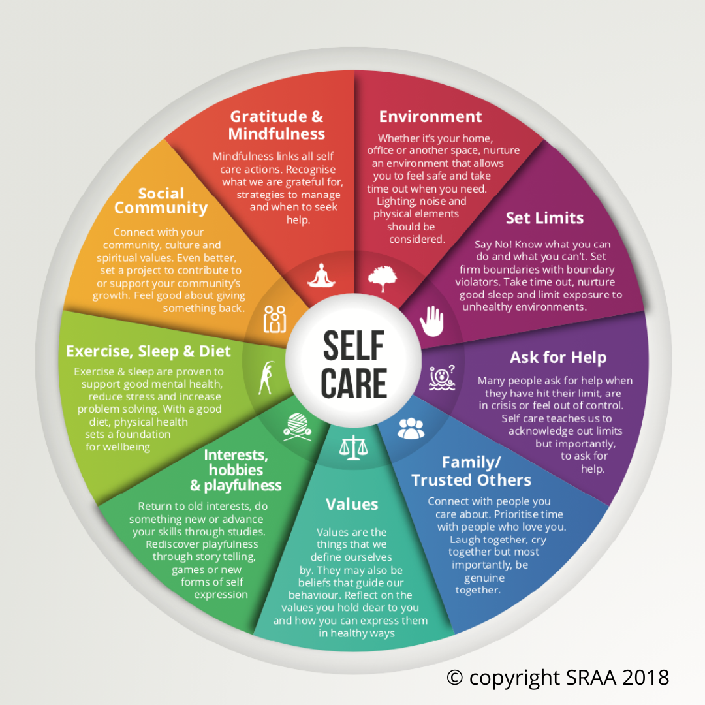
FCAWA Workplace Wellbeing Toolkit
Understanding stress
Individual/workplace wellbeing
Quick tips
Self care Assessment
Self-care planning
Workplace supports and responsibilities
FCAWA supports
Community resources and services

